Slide 1
ZigBee and 802.15.4 for Personal Area and Sensor Networks
CS 117, Winter 2012

Slide 2
Outline
ZigBee and 802.15.4 solution
ZigBee vs Bluetooth
Applications
Case study: interference between ZigBee and WiFI (BodyNets 2009)

Slide 3
The ZigBee Alliance Solution
Targeted at home and building automation and controls, consumer electronics, PC peripherals, medical monitoring, and toys
Industry standard through application profiles running over IEEE 802.15.4 radios
Primary drivers are simplicity, long battery life, networking capabilities, reliability, and cost
Alliance provides interoperability and certification testing

Slide 4
The Wireless Market
TEXT
GRAPHICS
INTERNET
HI-FI
AUDIO
STREAMING
VIDEO
DIGITAL
VIDEO
MULTI-CHANNEL
VIDEO
802.11b
LAN
SHORT < RANGE > LONG
802.11a/HL2 & 802.11g
Bluetooth 2
ZigBee
PAN
Bluetooth1
LOW < DATA RATE > HIGH

Slide 5





Applications
security
HVAC
AMR
lighting control
access control
BUILDING
AUTOMATION
CONSUMER ELECTRONICS
TV
VCR
DVD/CD
remote
patient monitoring
fitness monitoring
PERSONAL HEALTH CARE
PC & PERIPHERALS
ZigBee
Wireless Control that
Simply Works
mouse
keyboard
joystick
INDUSTRIAL
CONTROL
RESIDENTIAL/
LIGHT COMMERCIAL CONTROL
asset mgt
process control
environmental
energy mgt
security
HVAC
lighting control
access control
lawn & garden irrigation
Notes:
Future applications include Toys and Games, like consoles controllers, portable game pads (like gameboys), educational toys like leap frog stuff, and fun toys like RC (remote control) toys, etc.

Slide 6




Promoter Companies

Slide 7
Development of the Standard
ZigBee Alliance
50+ companies: semiconductor mfrs, IP providers, OEMs, etc.
Defining upper layers of protocol stack: from network to application, including application profiles
First profiles published mid 2003
IEEE 802.15.4 Working Group
Defining lower layers of protocol stack: MAC and PHY
APPLICATION
Customer
ZIGBEE STACK
ZigBee
Alliance
SILICON
IEEE
802.15.4

Slide 8
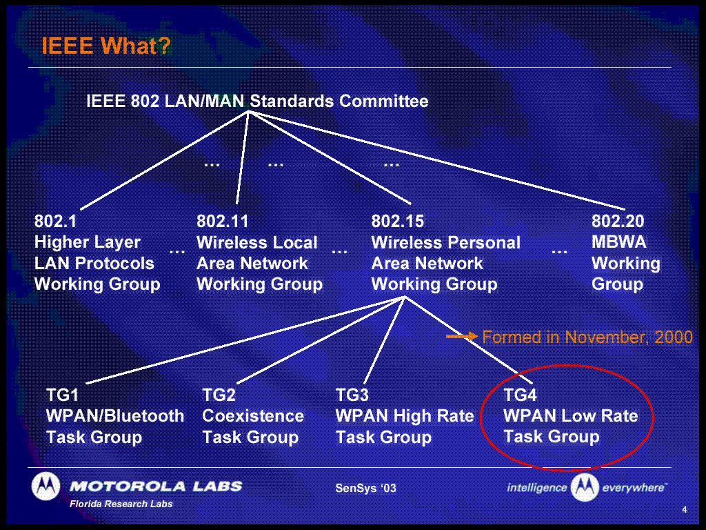

Slide 9
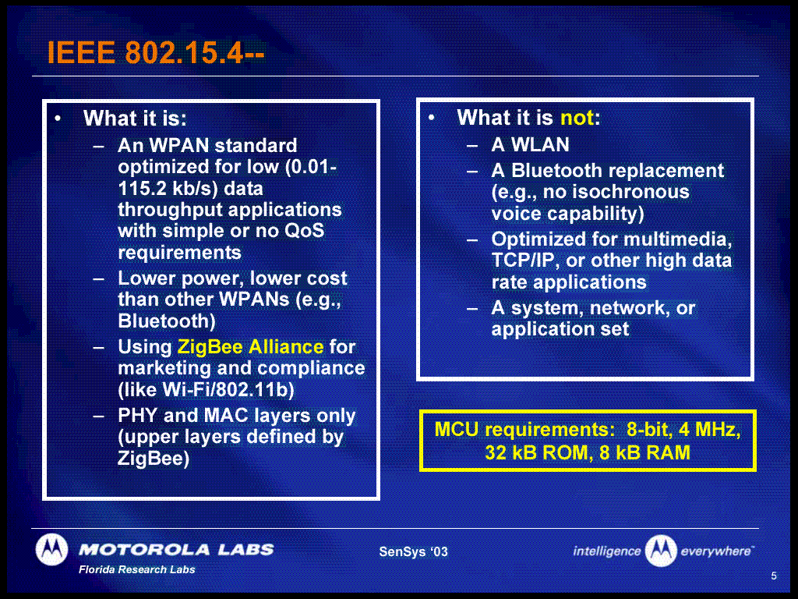

Slide 10
IEEE 802.15.4 Basics
802.15.4 is a simple packet data protocol for lightweight wireless networks
Channel Access
Carrier Sense Multiple Access with collision avoidance (but, no RTS/CTS)
optional time slotting
Message acknowledgement and an optional beacon structure
Three bands, 27 channels specified
2.4 GHz: 16 channels, 250 kbps
868.3 MHz : 1 channel, 20 kbps
902-928 MHz: 10 channels, 40 kbps
Works well for
Long battery life, selectable latency for controllers, sensors, remote monitoring and portable electronics
Configured for maximum battery life, has the potential to last as long as the shelf life of most batteries

Slide 11
Introduction to the IEEE 802.15.4 Standard
IEEE 802.15.4 standard released May 2003
Semiconductor manufacturers
Sampling Transceiver ICs and platform hardware/software to Alpha Customers now
Users of the technology
Defining application profiles for the first products, an effort organized by the ZigBee Alliance

Slide 12
IEEE 802.15.4 standard
Comprises layers up to and including Link Layer Control
LLC is standardized in 802.1
Supports multiple network topologies including Star, Cluster Tree and Mesh
Features of the MAC: Association/dissociation, ACK, frame delivery, channel access mechanism, frame validation, guaranteed time slot management, beacon management, channel scan
Low complexity: 26 primitives versus 131 primitives for 802.15.1 (Bluetooth)
ZigBee Application Framework
Networking App Layer (NWK)
Data Link Controller (DLC)
IEEE 802.15.4 LLC
IEEE 802.2
LLC, Type I
IEEE 802.15.4 MAC
IEEE 802.15.4
IEEE 802.15.4
868/915 MHz PHY
2400 MHz PHY
Notes:
Channel scan for beacon is included, but it is left to the network layer to implement dynamic channel selection

Slide 13
IEEE 802.15.4 MAC Overview
Employs 64-bit IEEE & 16-bit short addresses
Ultimate network size can reach 2⁶⁴ nodes (more than we’ll probably need…)
Using local addressing, simple networks of more than 65,000 (2^16) nodes can be configured, with reduced address overhead
Three devices specified
Network Coordinator
Full Function Device (FFD)
Reduced Function Device (RFD)
Simple frame structure
Reliable delivery of data
Association/disassociation
AES-128 security
CSMA-CA channel access
Optional superframe structure with beacons

Slide 14
IEEE 802.15.4 Device Types
Three device types
Network Coordinator
Maintains overall network knowledge; most sophisticated of the three types; most memory and computing power
Full Function Device
Carries full 802.15.4 functionality and all features specified by the standard
Additional memory, computing power make it ideal for a network router function
Could also be used in network edge devices (where the network touches the real world)
Reduced Function Device
Carriers limited (as specified by the standard) functionality to control cost and complexity
General usage will be in network edge devices
All of these devices can be no more complicated than the transceiver, a simple 8-bit MCU and a pair of AAA batteries!

Slide 15
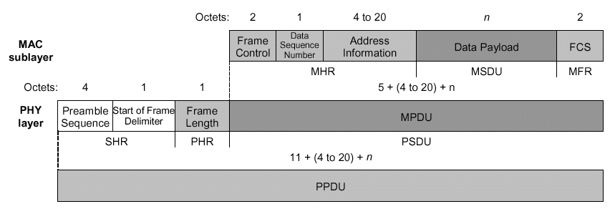
Data Frame format
One of two most basic and important structures in 15.4
Provides up to 104 byte data payload capacity
Data sequence numbering to ensure that all packets are tracked
Robust frame structure improves reception in difficult conditions
Frame Check Sequence (FCS) ensures that packets received are without error
Notes:
Frame control: + type of frame (4 types), format of address field, controls Ack, I.e. specifies how the frame looks and what it contains. The ACK and MAC command are lower level used for peer-to-peer
Sequence number: and Frame check sequency: verifies the integrity of the MAC frame. A transmission is considered successful if the ack frame contains the same sequence number as the previous frame. FCS is a 16-bit cyclic redundancy check (CRC)
Address field size: can contain both source and destination info

Slide 16
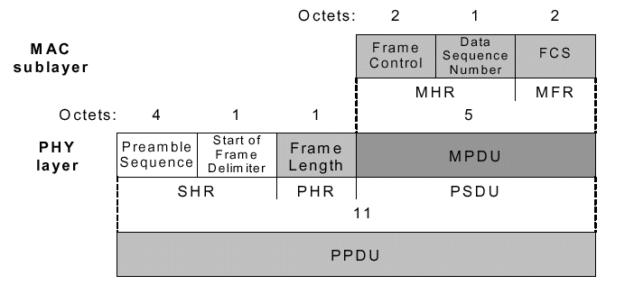
Acknowledgement Frame Format
The other most important structure for 15.4
Provides active feedback from receiver to sender that packet was received without error
Short packet that takes advantage of standards-specified “quiet time” immediately after data packet transmission
Notes:
Frame control: + type of frame (4 types), format of address field, controls Ack, I.e. specifies how the frame looks and what it contains. The ACK and MAC command are lower level used for peer-to-peer
Sequence number: and Frame check sequency: verifies the integrity of the MAC frame. A transmission is considered successful if the ack frame contains the same sequence number as the previous frame. FCS is a 16-bit cyclic redundancy check (CRC)
Address field size: can contain both source and destination info

Slide 17
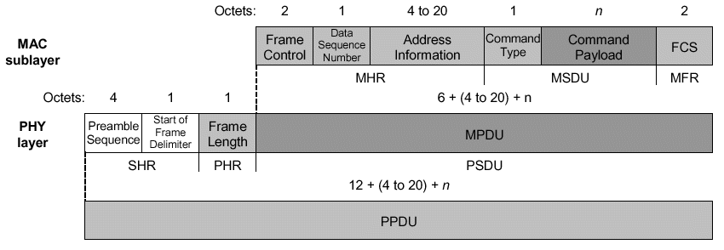
MAC Command Frame format
Mechanism for remote control/configuration of client nodes
Allows a centralized network manager to configure individual clients no matter how large the network
Notes:
Frame control: + type of frame (4 types), format of address field, controls Ack, I.e. specifies how the frame looks and what it contains. The ACK and MAC command are lower level used for peer-to-peer
Sequence number: and Frame check sequency: verifies the integrity of the MAC frame. A transmission is considered successful if the ack frame contains the same sequence number as the previous frame. FCS is a 16-bit cyclic redundancy check (CRC)
Address field size: can contain both source and destination info

Slide 18
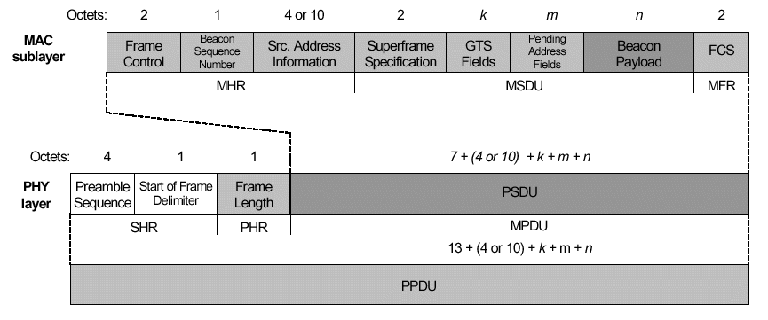
Beacon Frame format
Beacons add a new level of functionality to a network
Client devices can wake up only when a beacon is to be broadcast, listen for their address, and if not heard, return to sleep
Beacons are important for mesh and cluster tree networks to keep all of the nodes synchronized without requiring nodes to consume precious battery energy listening for long periods of time
Notes:
Frame control: + type of frame (4 types), format of address field, controls Ack, I.e. specifies how the frame looks and what it contains. The ACK and MAC command are lower level used for peer-to-peer
Sequence number: and Frame check sequency: verifies the integrity of the MAC frame. A transmission is considered successful if the ack frame contains the same sequence number as the previous frame. FCS is a 16-bit cyclic redundancy check (CRC)
Address field size: can contain both source and destination info

Slide 19
MAC Options
Two channel access mechanisms
Non-beacon network
Standard ALOHA CSMA-CA communications
Positive acknowledgement for successfully received packets
Beacon-enabled network
Superframe structure
For dedicated bandwidth and low latency
Set up by network coordinator to transmit beacons at predetermined intervals
15ms to 252sec (15.38ms*2n where 0 ≤ n ≤ 14)
16 equal-width time slots between beacons
Channel access in each time slot is contention free
Three security levels specified
None
Access control lists
Symmetric key employing AES-128
Notes:
Carrier sense multiple access with collision avoidance CSMA-CA

Slide 20
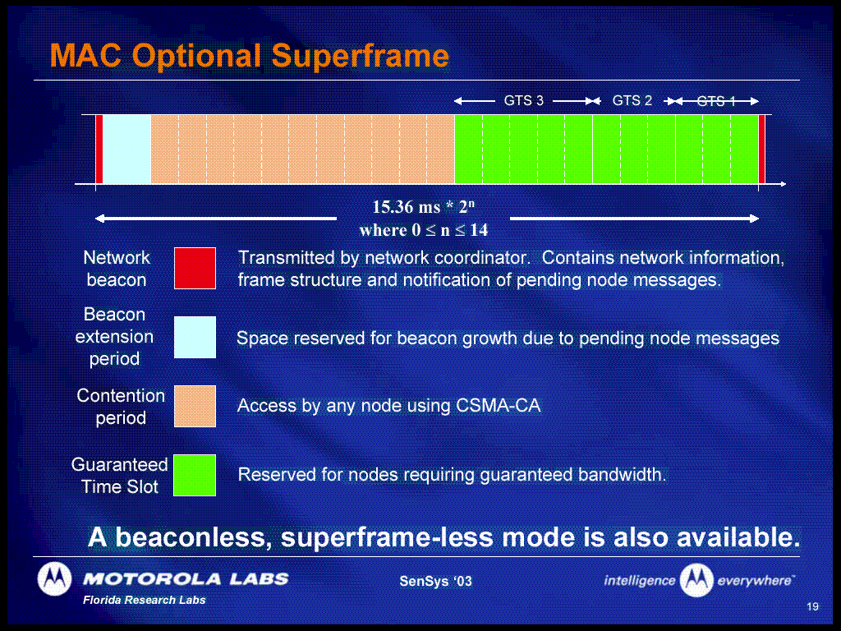

Slide 21
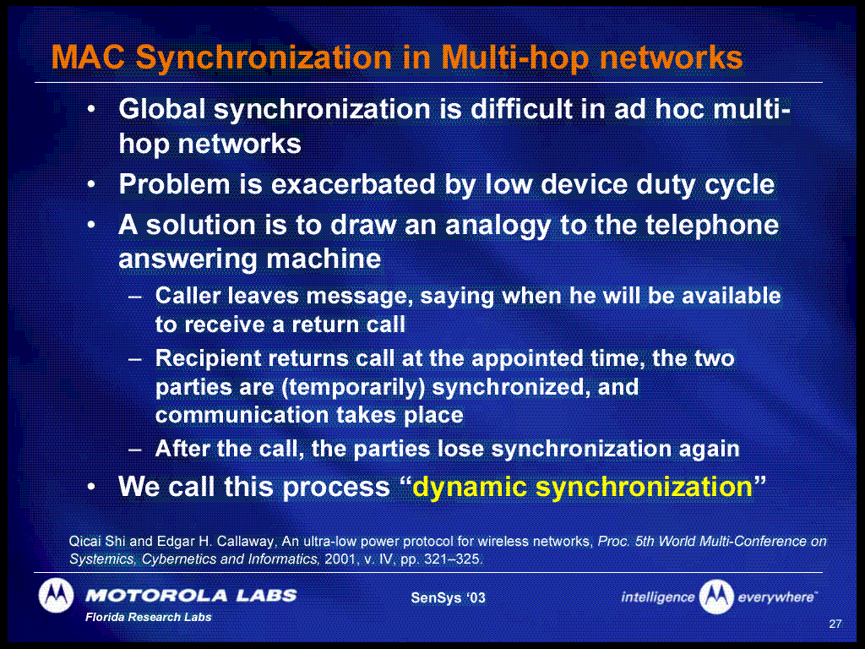

Slide 22
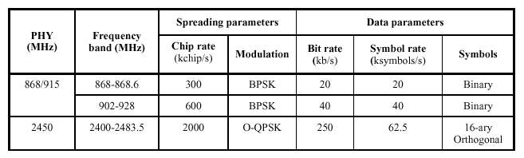
Frequencies and Data Rates
The two PHY bands (UHF/Microwave) have different physical, protocol-based and geopolitical characteristics
Worldwide coverage available at 2.4GHz at 250kbps
900MHz for Americas and some of the Pacific
868MHz for European-specific markets

Slide 23
ISM Band Interference and Coexistence
Potential for interference exists in every ISM band, not just 2.4GHz
IEEE 802.11 and 802.15.2 committees are addressing coexistence issues
ZigBee/802.15.4 Protocol is very robust
Clear channel checking before transmission
Backoff and retry if no acknowledgement received
Duty cycle of a ZigBee-compliant device is usually extremely low
It’s the “cockroach that survives the nuclear war”
Waits for an opening in otherwise busy RF spectrum
Waits for acknowledgements to verify packet reception at other end

Slide 24
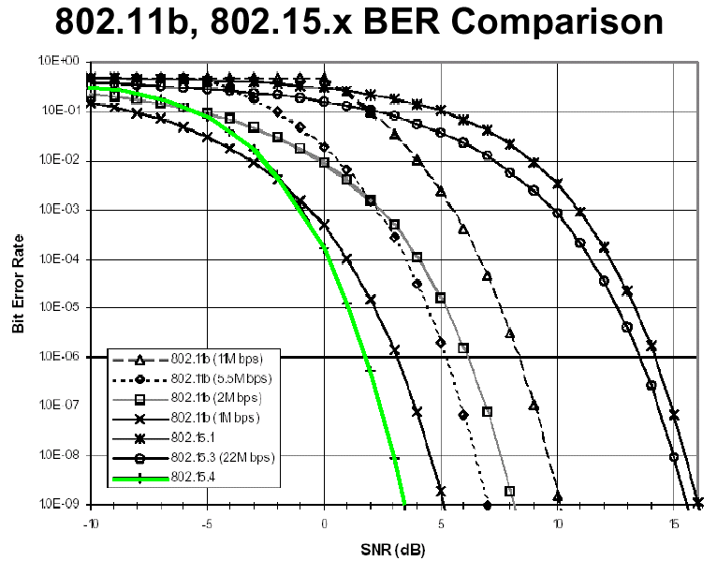
PHY Performance
802.15.4 has excellent performance in low SNR environments

Slide 25
Stack Reference Model
End developer applications, designed using application profiles
ZA1
ZA2
…
ZAn
IA1
IAn
Application interface designed using
general profile
API
UDP
Topology management, MAC management, routing, discovery protocol, security management
ZigBee NWK
IP
802.2 LLC
MAC (SSCS)
Channel access, PAN maintenance, reliable data transport
IEEE 802.15.4 MAC (CPS)
Transmission & reception on the physical radio channel
IEEE 802.15.4 PHY

Slide 26
Protocol Stack Features
Microcontroller utilized
Full protocol stack <32 k
Simple node-only stack ~4k
Coordinators require extra RAM
Node device database
Transaction table
Pairing table
APPLICATIONS
Customer
APPLICATION INTERFACE
SECURITY
NETWORK LAYER
Star/Cluster/Mesh
ZigBee
Alliance
MAC LAYER
MAC LAYER
IEEE
802.15.4
PHY LAYER
2.4 GHz 915MHz 868 MHz
Application
ZigBee Stack
Silicon

Slide 27
Choosing ZigBee technology over other protocols
Choose ZigBee when
Your application requires a standards-based wireless network solution
Simple to develop and deploy
Flexible networking that can automatically (or under network control) adjust to fit the physical plant characteristics
Optimized for applications requiring
Low cost
Low data rate
Long battery life
Robust security
High data reliability
Product interoperability

Slide 28
ZigBee Topology Models
Mesh
Star
Cluster Tree
ZigBee coordinator
ZigBee Routers
ZigBee End Devices

Slide 29
Non-Beacon vs Beacon Modes
Non-Beacon Mode
A simple, traditional multiple access system used in simple peer and near-peer networks
Think of it like a two-way radio network, where each client is autonomous and can initiate a conversation at will, but could interfere with others unintentionally
However, the recipient may not hear the call or the channel might already be in use
Beacon Mode
A very powerful mechanism for controlling power consumption in extended networks like cluster tree or mesh
Allows all clients in a local piece of the network the ability to know when to communicate with each other
Here, the two-way radio network has a central dispatcher who manages the channel and arranges the calls
As you’ll see, the primary value will be in system power consumption

Slide 30
Example of Non-Beacon Network
Commercial or home security
Client units (intrusion sensors, motion detectors, glass break detectors, standing water sensors, loud sound detectors, etc)
Sleep 99.999% of the time
Wake up on a regular yet random basis to announce their continued presence in the network (“12 o’clock and all’s well”)
When an event occurs, the sensor wakes up instantly and transmits the alert (“Somebody’s on the front porch”)
The ZigBee Coordinator, mains powered, has its receiver on all the time and so can wait to hear from each of these stations
Since ZigBee Coordinator has “infinite” source of power it can allow clients to sleep for unlimited periods of time to allow them to save power

Slide 31
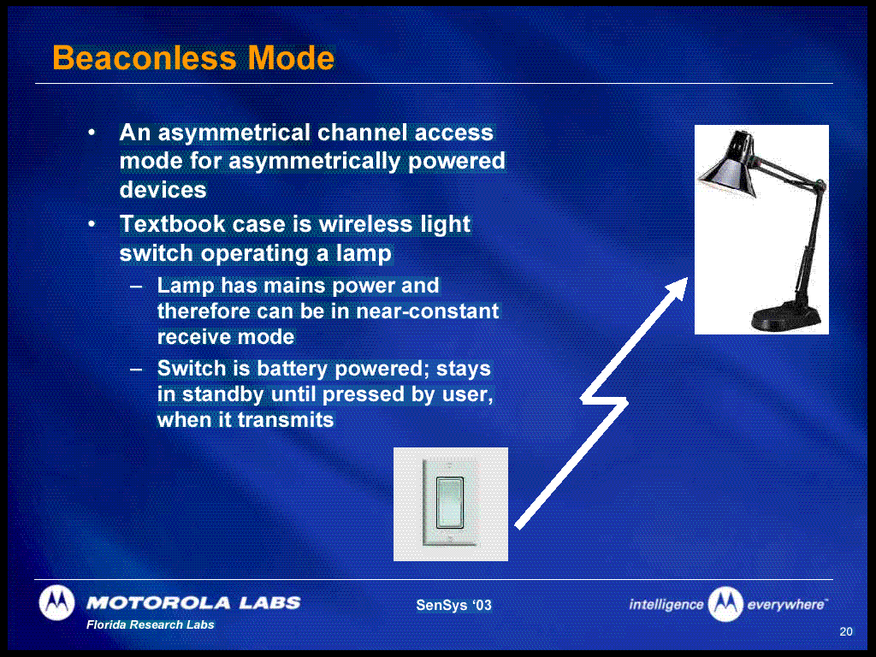

Slide 32
Example of Beacon Network
Now make the ZigBee Coordinator battery-operated also
All units in system are now battery-operated
Client registration to the network
Client unit when first powered up listens for the ZigBee Coordinator’s network beacon (interval between 0.015 and 252 seconds)
Register with the coordinator and look for any messages directed to it
Return to sleep, awaking on a schedule specified by the ZigBee Coordinator
Once client communications are completed, ZigBee coordinator also returns to sleep
This timing requirement potentially impacts the cost of the timing circuit in each end device
Longer intervals of sleep mean that the timer must be more accurate or
Turn on earlier to make sure that the beacon is heard, increasing receiver power consumption, or
Improve the quality of the timing oscillator circuit (increase cost) or
Control the maximum period of time between beacons to not exceed 252 seconds, keeping oscillator circuit costs low

Slide 33
Growing the Network
In a beacon-environment, growing the network means keeping the overall network synchronized
According to pre-existing network rules, the joining network’s PAN Coordinator is probably demoted to Router, and passes along information about its network (as required) to the PAN coordinator
Beacon information passed from ZigBee Coordinator to now-Router, router knows now when to awake to hear network beacon
Joining Network
Existing network’s Coordinator
Demoted to router
New link established

Slide 34
ZigBee and Bluetooth
Competitive or Complementary?

Slide 35





ZigBee and Bluetooth
Optimized for different applications
ZigBee
Smaller packets over large network
Mostly Static networks with many, infrequently used devices
Home automation, toys, remote controls, etc.
Bluetooth
Larger packets over small network
Ad-hoc networks
File transfer
Screen graphics, pictures, hands-free audio, Mobile phones, headsets, PDAs, etc.

Slide 36
ZigBee and Bluetooth
Address Different Needs
Bluetooth is a cable replacement for items like Phones, Laptop Computers, Headsets
Bluetooth expects regular charging
Target is to use <10% of host power

Slide 37
ZigBee and Bluetooth
Address Different Needs
ZigBee is better for devices where the battery is ‘rarely’ replaced
Targets are :
Tiny fraction of host power
New opportunities where wireless not yet used

Slide 38


Air interface
ZigBee and Bluetooth
ZigBee
DSSS- 11 chips/ symbol
62.5 K symbols/s
4 Bits/ symbol
Peak Information Rate
~128 Kbit/second
Bluetooth
FHSS
1 M Symbol / second
Peak Information Rate
~720 Kbit / second

Slide 39
Protocol Stack Comparison
ZigBee and Bluetooth
User Interface
Application
Voice
Intercom
Headset
Cordless
Group Call
vCard
vCal
vNote
vMessage
Dial-up
Networking
Fax
Service
Discovery
Protocol
Application Interface
Telephony
Control
Protocol
OBEX
Network Layer
RFCOMM
(Serial Port)
Data Link Layer
L2CAP
Host Control Interface
Link Manager
MAC Layer
MAC Layer
Link Controller
PHY Layer
Baseband
RF
Silicon
ZigBee Stack
Application
Silicon
Bluetooth Stack
Applications
Zigbee
Bluetooth

Slide 40
ZigBee and Bluetooth
Timing Considerations
ZigBee:
Network join time = 30ms typically
Sleeping slave changing to active = 15ms typically
Active slave channel access time = 15ms typically
Bluetooth:
Network join time = >3s
Sleeping slave changing to active = 3s typically
Active slave channel access time = 2ms typically
ZigBee protocol is optimized for timing critical applications

Slide 41
ZigBee and Bluetooth
Bluetooth ZigBee
AIR INTERFACE FHSS DSSS
PROTOCOL STACK 250 kb 28 kb
BATTERY rechargeable non-rechargeable
DEVICES/NETWORK 8 255
LINK RATE 1 Mbps 250 kbps
RANGE ~10 meters (w/o pa) ~30 meters
Comparison Overview

Slide 42
An Application Example
Battery Life & Latency in a Light Switch
Wireless Light switch –
Easy for Builders to Install
A Bluetooth Implementation would either :
keep a counter running so that it could predict which hop frequency the light would have reached or
use the inquiry procedure to find the light each time the switch was operated.

Slide 43
Light switch using Bluetooth
Option 1: use counter to predict hop frequency reached by light
The two devices must stay within 60 us (~1/10 of a hop)
With 30ppm crystals, devices need to communicate once a second to track each other's clocks.
Assume this could be improved by a factor of 100 then devices would need to communicate once every 100 seconds to maintain synchronization.
=> 900 communications / day with no information transfer + perhaps 4 communications on demand
99.5% Battery Power wasted

Slide 44
Light switch using Bluetooth
Option 2: Inquiry procedure to locate light each time switch is operated
Bluetooth 1.1 = up to 10 seconds typical
Bluetooth 1.2 = several seconds even if optimized
Unacceptable latency

Slide 45
Light switch using ZigBee
With DSSS interface, only need to perform CSMA before transmitting
Only 200 µs of latency
Highly efficient use of battery power
ZigBee offers longer battery life and lower latency than a Bluetooth equivalent.

Slide 46
Conclusion
ZigBee and Bluetooth
ZigBee targets applications not addressable by Bluetooth or any other wireless standard
ZigBee and Bluetooth complement for a broader solution

